Slide 1

DAVI CA2 PART 1
ANALYSIS ON STUDENTS
Rejey Ezekiel Jeyakumar

Slide 2

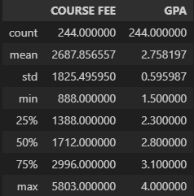
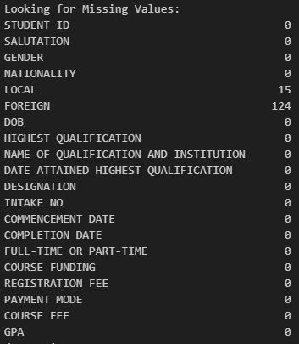
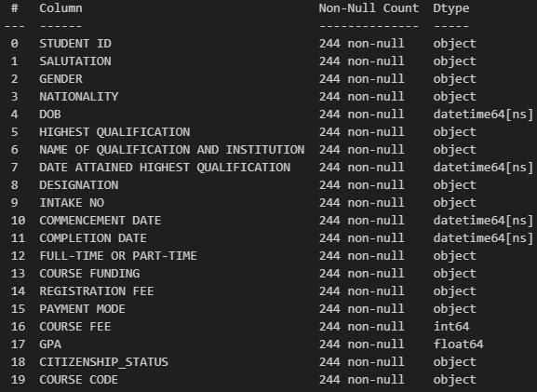
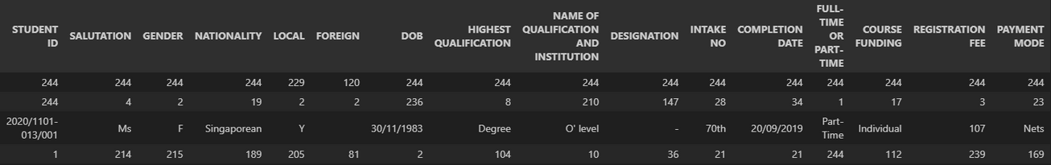
EXPLAINING THE DATASET
The dataset includes 19columns there are 4 datetime column, 1 float column, 1 integer column and lastly 13 object columns.
And looking for missing values we can see that only local and foreign columns have null values 14 & 124.
We can also see that there are 244 data entries and the distribution of the 2 numerical columns COURSE FEE and GPA.
Lastly got the object datatypes we can their Count, Unique Values, Top and Frequency.

Slide 3

DATA WRANGLING
Firstly i did some EDA to find out the properties of the dataset, and also going through the meta data to see if the data match up with the meta data.
After that i combines the Foreign and Local column into Citizenship_Status where L is Local and F is Foreign.
After that i combined Highest Qualification similar Qualifications Together and changed the empty strings to No Qualification
Then i made Payment mode to NETS, Giro, Cr Card and Bank Transfer
I made removed the wrongly spelled Mr in Salutation
Converted all time series column to pandas datetime with the same format yyyy-mm-dd
Made waived in registration fee to 0 to make column integer.
and for COURSE FUNDING i convert it into 3 categories Subsidiesed, Sponsorship and Individual
for Intake no i replaced the rd with th to keep it consistent with the dataset

Slide 4
DATA WRANGLING
Changed empty strings and ‘-’ to no Qualification in the NAME OF QUALIFICATION AND INSTITUTION column.
Changed ‘-’ to No Designation in the NAME OF QUALIFICATION AND INSTITUTION column.
Made Nationality into 3 Categories Singaporean, Permanent Resident and Foreigner.
Reversed the Completion date and Commencement date as the dates are reversed and is giving negative values when differenced.
created a new column date_diff which is the difference in commencement and completion dates.
Created a new column COURSE from extracting the students course from their Student ID.
Created Age column deriving from DOB column.

Slide 5

OBJECTIVE
"How can we reduce the performance gap between Singaporean and foreign students while raising overall academic standards?"
At Singapore's OX International School, Dean Mikey sat in her office, poring over the latest academic performance data. Data given by the school shoed that while foreign students consistently clustered in the higher GPA ranges, Singaporean students showed a wider, more scattered distribution, "Our goal isn't just to close the gap, but to elevate everyone's performance."

Slide 6

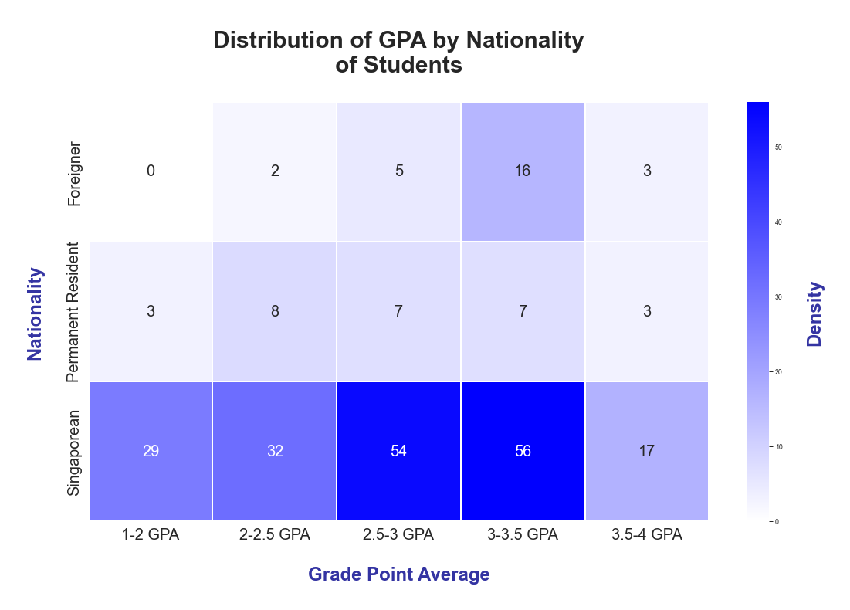
BIVARIATE PLOT
1ST PLOT
Heatmap
This plot is a Distribution of GPA against Nationality.
Each cell contains a number representing the count of students in that Nationality and GPA range.
Singaporeans have the highest overall number of students across all GPA ranges.
Foreigners tend to perform better on average, with most clustered in the higher GPA ranges.
Permanent Residents show a more even distribution across GPA ranges compared to the other two groups.
The 3-3.5 GPA range has the highest total number of students across all nationalities.

Slide 7
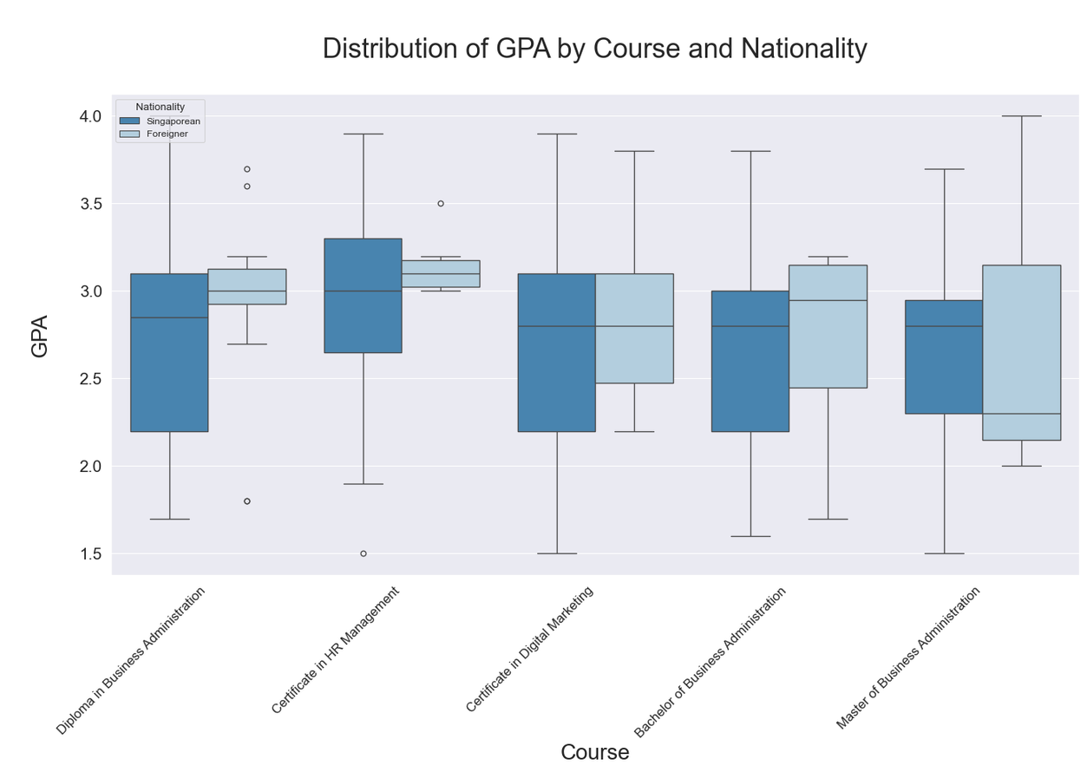
MULTI VARIABLE PLOT
2ND PLOT
Box Plot
This graph shows the distribution of GPA across different courses and nationalities
Foreigners tend to have higher median GPAs or similar median GPAs compared to Singaporeans.
Singaporeans consistently show wider GPA distributions across all courses.
Both groups have outliers, but Singaporeans tend to have more low outliers.
The Certificate in HR Management shows the highest median GPAs for both groups.
The Master of Business Administration shows the largest difference in median GPAs between the two groups

Slide 8
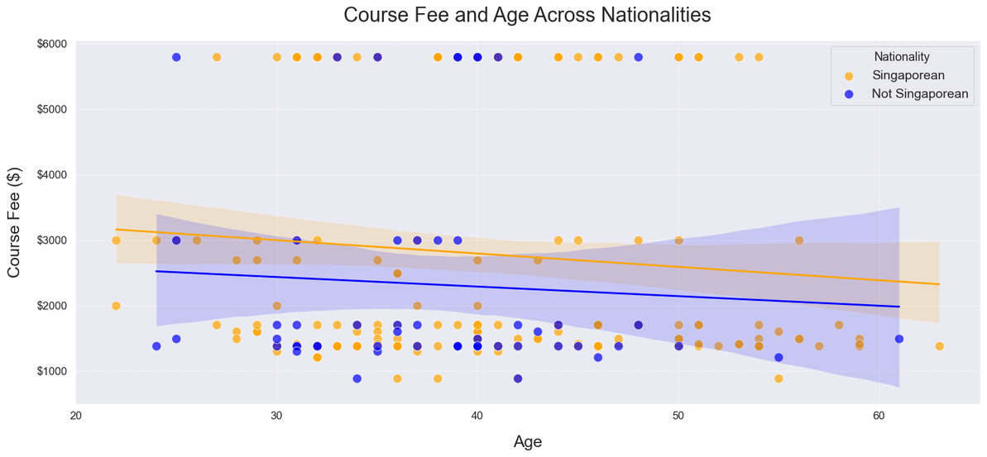
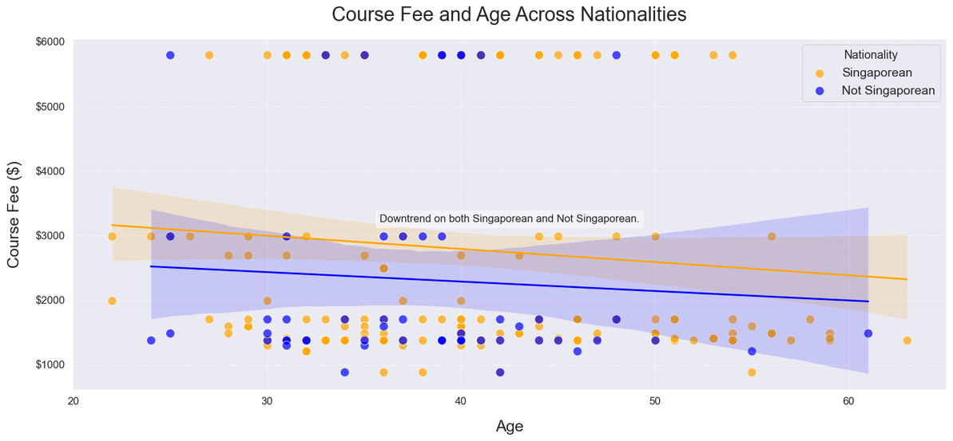
MULTI VARIABLE PLOT
3RD PLOT
Scatter
Relationship between age and course fees over Nationality
There's a slight downward trend in course fees as age increases for both groups
Singaporeans (orange) generally seem to pay higher fees than non-Singaporeans (blue) as they receive lesser sponsorship and relief.
There's significant scatter in the data, with fees varying widely at all ages
Some very high fees (around $5000-$6000) are present for both groups, mostly in the 25-45 age range
The majority of fees cluster between $1000-$3000

Slide 9
RECOMMENDATION
I recommend Dean Mkey to implement targeted academic support programs for Singaporean students to help improve their overall GPA distribution. This could help close the slight performance gap with foreign students and potentially justify the higher fees they're paying. Allowing them to improve overall grades and Singaporeans Grades over the spectrum too. Secondly to launch a peer mentoring program, pairing high-performing students with those who were struggling

Slide 10
THANK YOU!

